Slide 1
Requirement Elicitation

Slide 2
Requirement elicitation
Requirement elicitation means collection of requirements.
The aims of the requirements elicitation process are to understand the work that stakeholders do and how they might use a new system to help support that work.
During requirements elicitation, software engineers work with stakeholders to find out about the application domain, work activities, the services and system features that stakeholders want, the required performance of the system, hardware constraints, and so on.

Slide 3
Challenges of requirement elicitation
Stakeholders often don’t know what they want from a computer system except in the most general terms; they may find it difficult to articulate what they want the system to do; they may make unrealistic demands because they don’t know what is and isn’t feasible.
Stakeholders in a system naturally express requirements in their own terms and with implicit knowledge of their own work. Requirements engineers, without experience in the customer’s domain, may not understand these requirements.
Different stakeholders, with diverse requirements, may express their requirements in different ways. Requirements engineers have to discover all potential sources of requirements and discover commonalities and conflict.
Political factors may influence the requirements of a system. Managers may demand specific system requirements because these will allow them to increase their influence in the organization.
The economic and business environment in which the analysis takes place is dynamic.

Slide 4
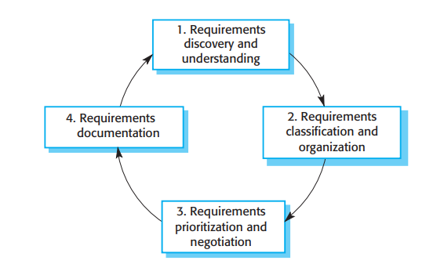
Process activities of requirement elicitation

Slide 5
Process activities of requirement elicitation
Requirements discovery and understanding This is the process of interacting with stakeholders of the system to discover their requirements. Domain requirements from stakeholders and documentation are also discovered during this activity.
Requirements classification and organization This activity takes the unstructured collection of requirements, groups related requirements and organizes them into coherent clusters.
Requirements prioritization and negotiation Inevitably, when multiple stakeholders are involved, requirements will conflict. This activity is concerned with prioritizing requirements and finding and resolving requirements conflicts through negotiation. Usually, stakeholders have to meet to resolve differences and agree on compromise requirements.
Requirements documentation The requirements are documented and input into the next round of the spiral. An early draft of the software requirements documents may be produced at this stage, or the requirements may simply be maintained informally on whiteboards, wikis, or other shared spaces.
Requirements elicitation and analysis is an iterative process with continual feedback from each activity to other activities.

Slide 6
Inevitably, different stakeholders have different views on the importance and priority of requirements, and sometimes these views are conflicting. If some stakeholders feel that their views have not been properly considered, then they may deliberately attempt to undermine the RE process. Therefore, it is important that you organize regular stakeholder meetings.
At the requirements documentation stage, it is important that you use simple language and diagrams to describe the requirements. This makes it possible for stakeholders to understand and comment on these requirements.

Slide 7
Requirement elicitation techniques
There are two fundamental approaches to requirements elicitation:
1. Interviewing, where you talk to people about what they do.
2. Observation or ethnography, where you watch people doing their job to see what artifacts they use, how they use them, and so on.
You should use a mix of interviewing and observation to collect information and, from that, you derive the requirements, which are then the basis for further discussions.

Slide 8
Interviewing
In interviews, the requirements engineering team puts questions to stakeholders about the system that they currently use and the system to be developed
Requirements are derived from the answers to these questions.
Interviews may be of two types:
1. Closed interviews, where the stakeholder answers a predefined set of questions.
2. Open interviews, in which there is no predefined agenda. The requirements engineering team explores a range of issues with system stakeholders and hence develops a better understanding of their needs.
In practice, interviews with stakeholders are normally a mixture of both of these.
You may have to obtain the answer to certain questions, but these usually lead to other issues that are discussed in a less structured way.
Completely open-ended discussions rarely work well.
You usually have to ask some questions to get started and to keep the interview focused on the system to be developed.

Slide 9
Challenges of requirement elicitations through interviews
All application specialists use jargon specific to their area of work. It is impossible for them to discuss domain requirements without using this terminology. They normally use words in a precise and subtle way that requirements engineers may misunderstand.
Some domain knowledge is so familiar to stakeholders that they either find it difficult to explain or they think it is so fundamental that it isn’t worth mentioning. For example, for a librarian, it goes without saying that all acquisitions are catalogued before they are added to the library. However, this may not be obvious to the interviewer, and so it isn’t taken into account in the requirements.

Slide 10
Points to be an effective interviewer
You should be open-minded, avoid preconceived ideas about the requirements, and willing to listen to stakeholders. If the stakeholder comes up with surprising requirements, then you should be willing to change your mind about the system.
You should prompt the interviewee to get discussions going by using a springboard question or a requirements proposal, or by working together on a prototype system. Saying to people “tell me what you want” is unlikely to result in useful information. They find it much easier to talk in a defined context rather than in general terms.

Slide 11
Ethnography
Ethnography is an observational technique that can be used to understand operational processes and help derive requirements for software to support these processes.
An analyst immerses himself or herself in the working environment where the system will be used.
The day-to-day work is observed, and notes are made of the actual tasks in which participants are involved.
The value of ethnography is that it helps discover implicit system requirements that reflect the actual ways that people work, rather than the formal processes defined by the organization.

Slide 12
Why ethnography?
People often find it very difficult to articulate details of their work because it is second nature to them.
They understand their own work but may not understand its relationship to other work in the organization.
Social and organizational factors that affect the work, but that are not obvious to individuals, may only become clear when noticed by an unbiased observer.
This may not be mentioned during an interview as the group might not see it as an integral part of their work.

Slide 13
Effectiveness of ethnography
Ethnography is particularly effective for discovering two types of requirements:
Requirements derived from the way in which people actually work, rather than the way in which business process definitions say they ought to work. In practice, people never follow formal processes.
Requirements derived from cooperation and awareness of other people’s activities. For example, air traffic controllers (ATCs) may use an awareness of other controlles’ work to predict the number of aircraft that will be entering their control sector. They then modify their control strategies depending on that predicted workload. Therefore, an automated ATC system should allow controllers in a sector to have some visibility of the work in adjacent sectors.

Slide 14
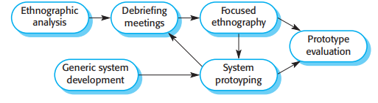
Ethnography and prototyping for requirements analysis

Slide 15
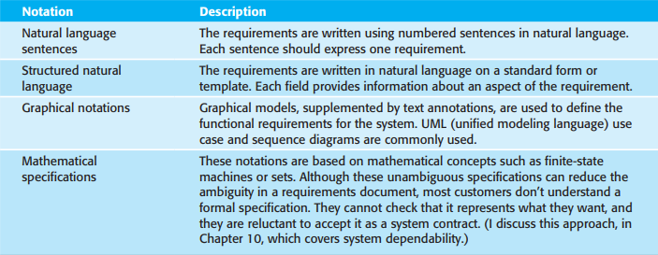
Requirements specification
Requirements specification is the process of writing down the user and system requirements in a requirements document.
Notations of writing system specifications

Slide 16
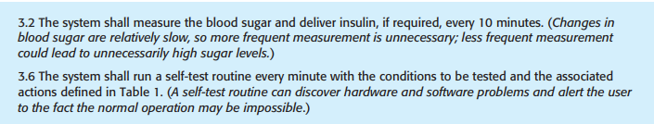
Natural language specification

Slide 17
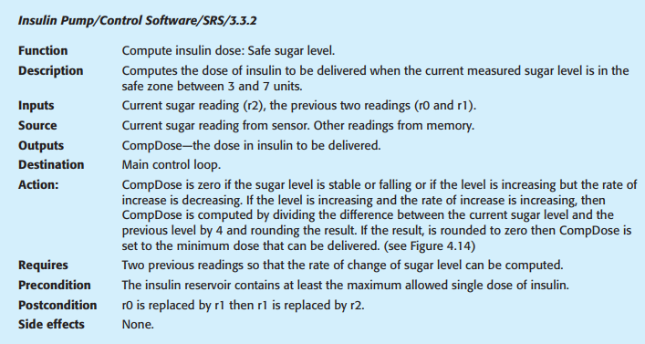
Structured language specification

Slide 18
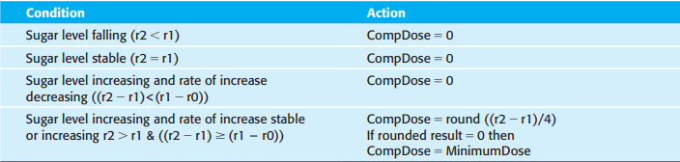

Slide 19
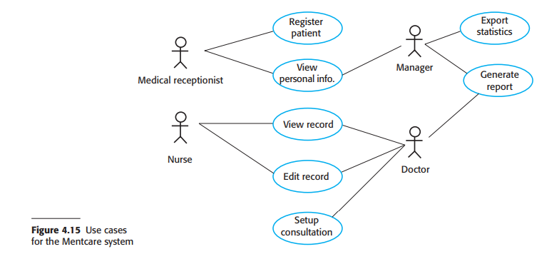
Use cases
Use cases are a way of describing interactions between users and a system using a graphical model and structured text.
Example of a use case from the below mentcare system

Slide 20
Setup consultation allows two or more doctors, working in different offices, to view the same patient record at the same time. One doctor initiates the consultation by choosing the people involved from a dropdown menu of doctors who are online. The patient record is then displayed on their screens, but only the initiating doctor can edit the record. In addition, a text chat window is created to help coordinate actions. It is assumed that a phone call for voice communication can be separately arranged.

